Slide 1
Transaction Management System

Slide 2
Basic Concepts
Single-User System: At most one user at a time can use the system.
Multiuser System: Many users can access the system concurrently.
Concurrency
Interleaved processing: concurrent execution of processes is interleaved in a single CPU
Parallel processing: processes are concurrently executed in multiple CPUs.

Slide 3
Introduction to Transaction Processing
A transaction is a unit of program execution that accesses and possibly updates various data items.
that means
A Transaction: logical unit of database processing that includes one or more access operations (read -retrieval, write - insert or update, delete).

Slide 4
Introduction to Transaction Processing
Basic operations are read and write read_item(X): Reads a database item named X into a program variable.
write_item(X): Writes the value of program
variable X into the database item named X.

Slide 5
READ AND WRITE OPERATIONS
Basic unit of data transfer from the disk to the computer main memory is one block.
In general, a data item (what is read or written) will be the field of some record in the database, although it may be a larger unit such as a whole block.

Slide 6
READ AND WRITE OPERATIONS
read_item(X) command includes the following steps:
Find the address of the disk block that contains item X.
Copy that disk block into a buffer in main memory (if that disk block is not already in some main memory buffer).
Copy item X from the buffer to the program variable named X.

Slide 7
READ AND WRITE OPERATIONS
write_item(X) command includes the following step:
Store the updated block from the buffer back to disk (either immediately or at some later point in time).

Slide 8
Introduction to Transaction Processing
E.g. transaction to transfer $50 from account A to account B
1. read(A)
2. A := A – 50
3. write(A)
4. read(B)
5. B := B + 50
6. write(B)

Slide 9
Introduction to Transaction Processing
A transaction (set of operations) may be standalone specified in a high level language like SQL submitted interactively, or may be embedded within a program.
Transaction boundaries: Begin and End transaction.
An application program may contain several transactions separated by the Begin and End transaction boundaries.

Slide 10
Introduction to Transaction Processing
Two main issues to deal with
Failures of various kinds, such as hardware failures and system crashes
Concurrent execution of multiple transactions

Slide 11
Transaction State
A transaction is an atomic unit of work that is either completed in its entirety or not done at all.
For recovery purposes, the system needs to keep track of when the transaction starts, terminates, and commits or aborts.

Slide 12
Transaction State
Active state
Partially committed state
Committed state
Failed state
Terminated State

Slide 13
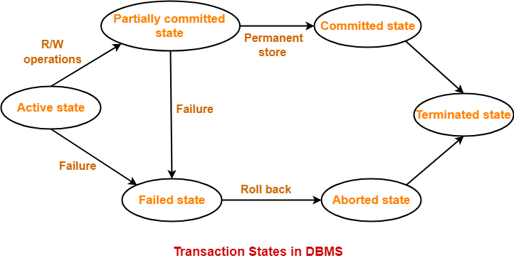
Transaction State

Slide 14
Transaction State
Active State
A transaction is a sequence of operations. If a transaction is in execution then it is said to be in active state.
It doesn’t matter which step is in execution, until unless the transaction is executing, it remains in active state.

Slide 15
Transaction State
Partially Committed State
From an active state transaction goes into “partially committed” state when there are read and write operations present in the transaction.
A transaction contains number of read and write operations. Once the whole transaction is successfully executed, the transaction goes into partially committed state where we have all the read and write operations performed on the main memory (local memory) instead of the actual database.

Slide 16
Transaction State
A transaction can fail during execution so if we are making the changes in the actual database instead of local memory, database may be left in an inconsistent state in case of any failure.
This state helps us to rollback the changes made to the database in case of a failure during execution.

Slide 17
Transaction State
Failed State
If a transaction is executing and a failure occurs, either a hardware failure or a software failure then the transaction goes into failed state from the active state.

Slide 18
Transaction State
Committed State
If a transaction completes the execution successfully then all the changes made in the local memory during partially committed state are permanently stored in the database.
A transaction goes from partially committed state to committed state when everything is successful.

Slide 19
Transaction State
Aborted State
If a transaction fails during execution then the transaction goes into a failed state.
The changes made into the local memory (or buffer) are rolled back to the previous consistent state and the transaction goes into aborted state from the failed state.

Slide 20
Atomicity Consistency Isolation Durability Properties
To preserve the integrity of data the database system must ensure ACID Properties
Atomicity: Either all operations of the transaction are properly reflected in the database or none are.
Consistency: Execution of a transaction in isolation preserves the consistency of the database. This means that integrity constraints must be maintained so that the database is consistent before and after the transaction. It refers to the correctness of a database

Slide 21
ACID Properties
Isolation: Although multiple transactions may execute concurrently, each transaction must be unaware of other concurrently executing transactions.
Intermediate transaction results must be hidden from other concurrently executed transactions.
That is, for every pair of transactions T_{i} and T_{j} , it appears to T_{i} that either T_{j}, finished execution before T_{i} started, or T_{j} started execution after T_{i} finished.

Slide 22
ACID Properties
Durability : After a transaction completes successfully, the changes it has made to the database persist, even if there are system failures.

Slide 23
Operations
commit_transaction: This signals a successful end of the transaction so that any changes (updates) executed by the transaction can be safely committed to the database and will not be undone.
rollback (or abort): This signals that the transaction has ended unsuccessfully, so that any changes or effects that the transaction may have applied to the database must be undone.

Slide 24
Example of Fund Transfer
Transaction to transfer $50 from account A to account B:
1. read(A)
2. A := A – 50
3. write(A)
4. read(B)
5. B := B + 50
6. write(B)

Slide 25
Example of Fund Transfer
Atomicity requirement
If the transaction fails after step 3 and before step 6, money will be “lost” leading to an inconsistent database state
Failure could be due to software or hardware
the system should ensure that updates of a partially executed transaction are not reflected in the database

Slide 26
Example of Fund Transfer
Consistency requirement :
the sum of A and B is unchanged by the execution of the transaction
In general, consistency requirements include
Explicitly specified integrity constraints such as primary keys and foreign keys
Implicit integrity constraints
e.g. sum of balances of all accounts, minus sum of loan amounts must equal value of cash-in-hand

Slide 27
Example of Fund Transfer
A transaction must see a consistent database.
During transaction execution the database may be temporarily inconsistent.
When the transaction completes successfully the database must be consistent
Erroneous transaction logic can lead to inconsistency

Slide 28
Example of Fund Transfer
Isolation requirement — if between steps 3 and 6, another transaction T2 is allowed to access the partially updated database, it will see an inconsistent database (the sum A + B will be less than it should be). T1 T2
1. read(A)
2. A := A – 50
3. write(A) read(A), read(B), print(A+B)
4. read(B)
5. B := B + 50
6. write(B

Slide 29
Example of Fund Transfer
Isolation can be ensured trivially by running transactions serially
that is, one after the other.
However, executing multiple transactions concurrently has significant benefits, as we will see later .

Slide 30
Example of Fund Transfer
Durability requirement — once the user has been notified that the transaction has completed (i.e., the transfer of the $50 has taken place), the updates to the database by the transaction must persist even if there are software or hardware failures.

Slide 31
Concurrent Executions
Multiple transactions are allowed to run concurrently in the system. Advantages are:
increased processor and disk utilization, leading to better transaction throughput
E.g. one transaction can be using the CPU while another is reading from or writing to the disk
reduced average response time for transactions: short transactions need not wait behind long ones.

Slide 32
Concurrent Executions

Slide 33
Concurrent Executions
Concurrency control schemes – mechanisms to achieve isolation
that is, to control the interaction among the concurrent transactions in order to prevent them from destroying the consistency of the database

Slide 34
Schedules
Schedule – a sequences of instructions that specify the chronological order in which instructions of concurrent transactions are executed
a schedule for a set of transactions must consist of all instructions of those transactions
must preserve the order in which the instructions appear in each individual transaction.

Slide 35
Schedules
A transaction that successfully completes its execution will have a commit instructions as the last statement
by default transaction assumed to execute commit instruction as its last step
A transaction that fails to successfully complete its execution will have an abort instruction as the last statement

Slide 36
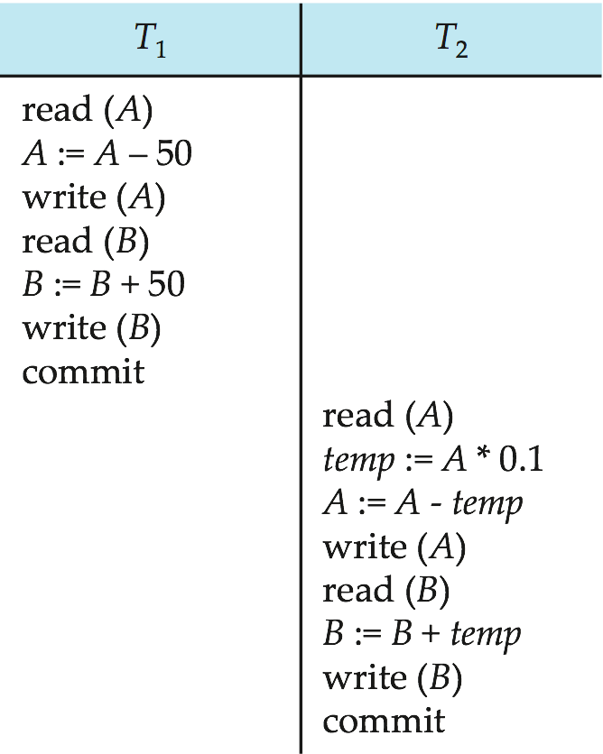
Schedule 1
Let T₁ transfer $50 from A to B, and T₂ transfer 10% of the balance from A to B.
A serial schedule in which T₁ is followed by T₂

Slide 37
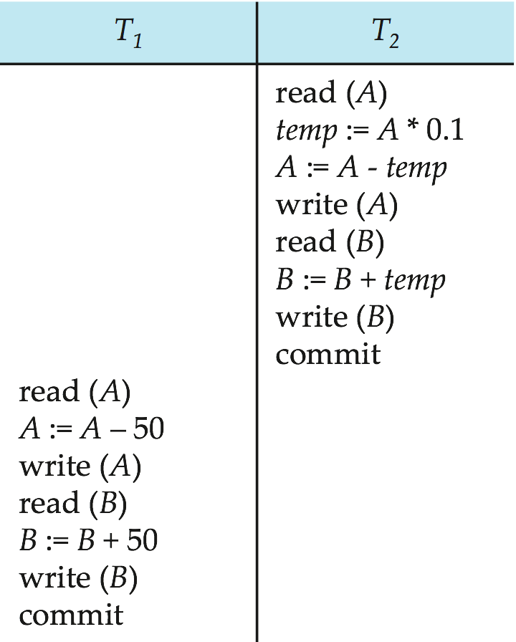
Schedule 2
A serial schedule where T₂ is followed by T₁

Slide 38
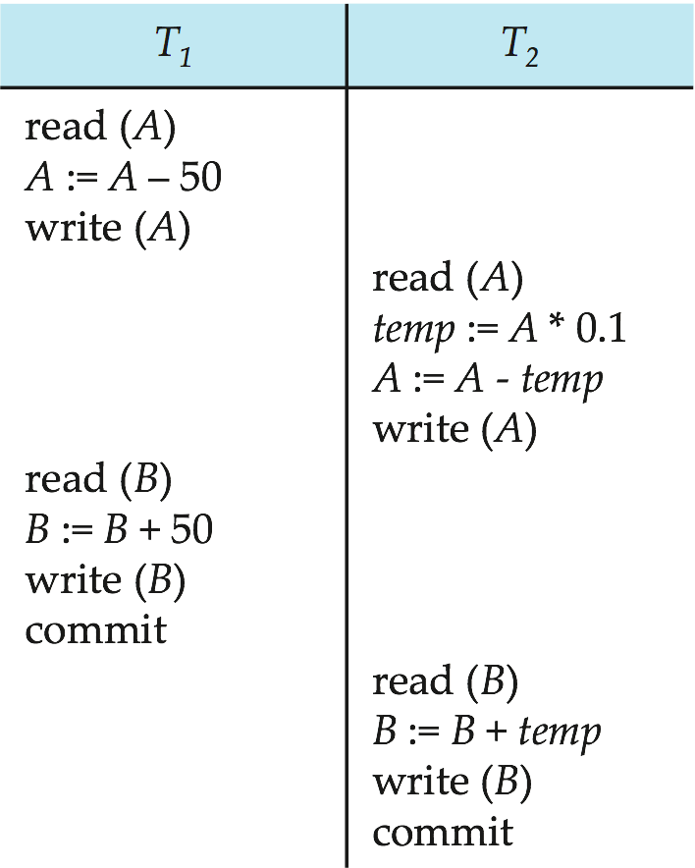
Schedule 3
Let T₁ and T₂ be the transactions defined previously. The following schedule is not a serial schedule, but it is equivalent to Schedule 1.
In Schedules 1, 2 and 3, the sum A + B is preserved.

Slide 39
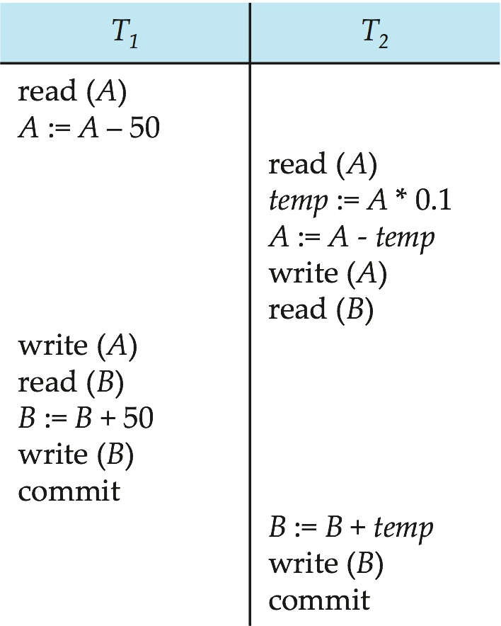
Schedule 4
The following concurrent schedule does not preserve the value of (A + B ).

Slide 40
Serializability
Basic Assumption – Each transaction preserves database consistency.
Thus serial execution of a set of transactions preserves database consistency.
A (possibly concurrent) schedule is serializable if it is equivalent to a serial schedule. Different forms of schedule equivalence give rise to the notions of:
1. conflict serializability
2. view serializability

Slide 41
Conflicting Instructions
Instructions l_{i} and l_{j} of transactions T_{i} and T_{j} respectively, conflict if and only if there exists some item Q accessed by both l_{i} and l_{j}, and at least one of these instructions wrote
1. l_{i} = read(Q), l_{j} = read(Q). l_{i} and l_{j} don’t
conflict. 2. l_{i} = read(Q), l_{j} = write(Q). They conflict. 3. l_{i} = write(Q), l_{j} = read(Q). They conflict 4. l_{i} = write(Q), l_{j} = write(Q). They conflict

Slide 42
Conflicting Instructions
Intuitively, a conflict between l_{i} and l_{j} forces a (logical) temporal order between them.
If l_{i} and l_{j} are consecutive in a schedule and they do not conflict, their results would remain the same even if they had been interchanged in the schedule.

Slide 43
Conflict Serializability
If a schedule S can be transformed into a schedule S´ by a series of swaps of non-conflicting instructions, we say that S and S´ are conflict equivalent.
We say that a schedule S is conflict serializable if it is conflict equivalent to a serial schedule

Slide 44
Conflict Serializability
Schedule 3 can be transformed into Schedule 6
A serial schedule where T2 follows T1, by a series of swaps of non-conflicting instructions. Therefore, Schedule 3 is conflict serializable.

Slide 45
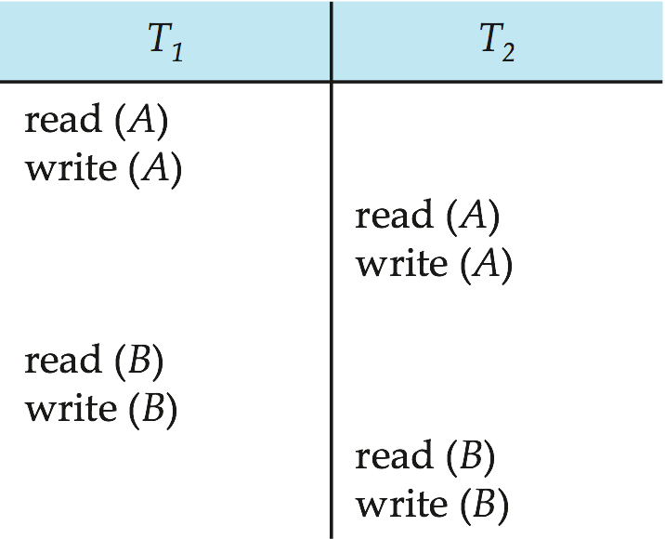
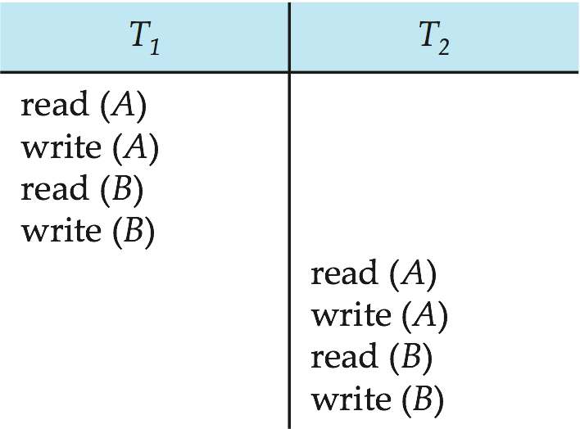
Conflict Serializability
Schedule 3
Schedule 6

Slide 46
Conflict Serializability
Example of a schedule that is not conflict serializable

Slide 47
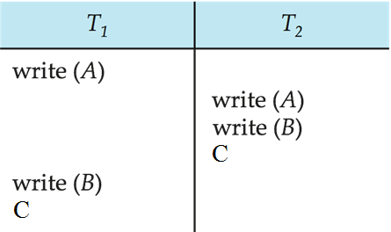
Anomalies with Interleaved Execution
Overwriting Uncommitted Data (WW Conflicts):
Values of A and B are equal
T1 makes A & B are 1000
T2 makes A & B are 2000

